Slide 1
Data Structures
H16Y 35

Slide 2
Part D: Abstract Data Types (ADTs)

Slide 3
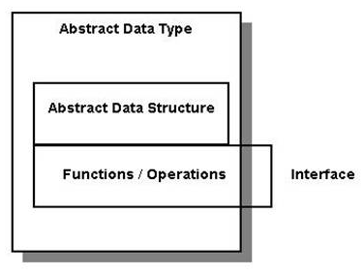
What are Abstract Data Types (ADTs) ?
According to the National Institute of Standards and Technology; ADTs can be defined as: A set of data values and associated operations that are precisely specified independent of any particular implementation.
An ADT is considered abstract because the operations performed on it are separated from the underlying implementation
Most data-structure ADTs can be implemented using either a contiguous (array-based) or linked-data representation
An ADT hides the implementation of a data structure behind a well-defined interface.
Diagrammatic representation of ADT

Slide 4
Abstract Data Types (ADTs) – Contd.
The abstract data type (ADT) is an abstraction of a data structure.
An ADT specifies:
Data stored
Operations on the data
Error conditions associated with operations.
For example: ADT modelling of a simple stock trading system
Stock Component:
Data stored - buy and sell orders of stocks
Operations supported by the ADT -
Order - buy (stock, shares, price)
Order - sell (stock, shares, price)
Void - cancel (order)
Error conditions supported by the ADT -
Buy or sell non-existent stock
Cancel a non-existent order.

Slide 5
ADT Structure.
ADT structure comprises of the following:
A name (the name of the ADT)
The data type(s) represented by a collection of data, which is structured in some manner [each type has been previously defined in a ADT (or it is a primitive type)]
Functions that operate on the data [the functions will specify the domain (parameters) and range (return type)]
Preconditions for each of the functions
Post-conditions for each of the functions
Error conditions that we need to consider.

Slide 6
ADT Components.- Contd.
Each ADT designed consists of the following parts:
Data:
This part describes the structure of the data used in the ADT.
Operations:
Describe valid operations for the ADT, for example – the interface.
Special Operations commonly used;
Constructor /Create to describe the actions to be performed once an entity of the ADT is created
Destructor / Destroy to describe the actions to be performed once an entity of the ADT is destroyed.
For each operation the provided arguments, as well as preconditions and post-conditions, are given.
Errors:
This part describes possible errors that may be encountered during the use of ADT setup.

Slide 7
Types of ADT.
Stack ADT
Queue ADT
List (Linked List) ADT
Set ADT
Map ADT
Tree ADT

Slide 8
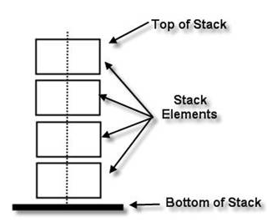
Stack ADT.
A linear sequence of arbitrary number of items, whose access procedures have a last-in, first-out (LIFO) behaviour.
A stack is either empty or it consists of two parts –
a top element
stack (the remaining elements).
The elements in a stack may be of any type, but all the elements in a given stack must be the same type
ADT Representation
LIFO – Last in First Out
If different boxes are stacked on top of one another, the last box to be added to the stack will have to be the first to be removed from the stack

Slide 9
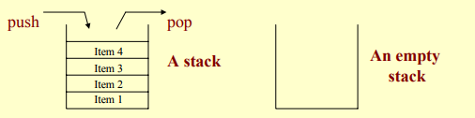
Stack ADT – Cont’d
The ADT Stack is a linear sequence of an arbitrary number of items, together with access procedures.
The access procedures permit insertions and deletion of items only at one end of the sequence (the “top”).
The stack is a list structure, sometimes called a last-in-first-out (or LIFO) list.
A stack is either empty, or it consists of a sequence of items. Access is limited to the “top” item on the stack at all times.

Slide 10
Stack ADT – Common Operations
In Stack ADT, the insertion or deletion of items in the stack usually follows a - Last In First Out (LIFO) concept.
Stack ADT Operations:
Push(Item): inserts an element
Item pop(): removes and returns the last inserted element
Item top(): returns the last inserted element without removing it
Integer size(): returns the number of elements stored
Boolean isEmpty(): indicates whether no elements are stored
Stack Error operations:
In Stack ADT, operations pop and top cannot be performed if the stack is empty, this can generate errors when prompted.

Slide 11
Stack ADT – Specification Conditions (Pre & Post)
Stack Specification | Pre & Post Conditions
CreateStack() | Pre-conditions: none Post-conditions: S (e.g. data entity) is defined and empty Inputs: no inputs required Outputs: S - a stack has been created Algorithm: stack is initialised.
DestroyStack() | Pre-conditions: none Post-conditions: S is undefined. All resources (eg memory) allocated to S have been released. No stack operation can be performed on S. Inputs: the stack Outputs: an empty stack Algorithm: stack is re-initialised
Pop(element) | Pre-conditions: stack is not empty Post-conditions: the top element has been removed from the stack Inputs: the stack Outputs: the changed stack, i.e. top element, has been removed Algorithm: remove the top element of the stack; give a copy of the element back to the user

Slide 12
Stack ADT – Specification Conditions (Pre & Post) Cont’d
Stack Specification | Pre & Post Conditions
Push(element) | Pre-conditions: the stack exists, element is of appropriate type Post-conditions: Element is put onto the top of the stack. Inputs: a stack and an element Outputs: a changed stack Algorithm: insert the element into the stack
IsEmpty() | Pre-conditions: none Post-conditions: S is undefined. All resources (eg memory) allocated to S have been released. No stack operation can be performed on S. Inputs: the stack Outputs: an empty stack Algorithm: stack is re-initialised
Source: http://www.sqa.org.uk/e-learning/LinkedDS02CD/page_23.htm

Slide 13
Stack ADT – Implementation in C#
Creating an ADT Interface to store Integers data sets
using System;
/*
using System.Collections.Generic;
using System.Linq;
using System.Text;
using System.Threading.Tasks;
*/
namespace <Your Initials>_ADTs
{
interface IStackADT
{
void push(int value);
int pop();
Boolean isEmpty();
int size();
}
}

Slide 14
Stack ADT – Implementation in C
Creating an ADT Interface to store Integers data sets
Note:
To implement the ADT interface created, a data structure type must be specified (built as algorithm) for storing the integer data sets declared when creating the interface.
Example of data structure type –
Arrays DS – IntArrayList
LinkedList DS – IntLinkedList

Slide 15
ADT – Common Terminologies Used
Stack
Queue
Push
Pop
LIFO
FIFO
Primitive Operations
Non-Primitive Operations
Recursion
Iteration.

Slide 16
Class Exercise – Tutorial 5
Question A.
Carry out research on Linked List and Queue ADTs using relevant online and recommended resources to answer the following questions
Brief description
Uses/Application
Operations
Question B.
Carry out research using relevant online and recommended resources to provide 2 examples of algorithms executable within C environment to implement Stack ADT. answer the following questions
Question C.
Use relevant online and recommended resources to briefly describe each of the ADT terminologies provided in the lecture slide.

Slide 17
Class Exercise – Tutorial
Question A.
Carry out research on Linked List and Queue ADTs using relevant online and recommended resources to answer the following questions
Brief description
Uses/Application
Operations
Question B.
Carry out research using relevant online and recommended resources to provide 2 examples of algorithms executable within C # environment to implement Stack and Queue ADTs.
Question C.
Use relevant online and recommended resources to briefly describe each of the ADT terminologies provided in the lecture slide.

